Slide 1

Integrating LLMs with Cybersecurity: Insights from "The Philosopher's Stone: Trojaning Plugins of Large Language Models"
This presentation explores the potential vulnerabilities of integrating Large Language Models (LLMs) with cybersecurity, analyzing the research paper "The Philosopher's Stone: Trojaning Plugins of Large Language Models" We will delve into the key threats, innovative defenses, and a novel proposal to strengthen the LLM ecosystem.
by Swapnali Dashrath, published on December 31, 2024.
Prof. Anyi Liu

Slide 2
The Rise of Trojaned LLMs
Open-Source Popularity
The Trojaning Threat
Open-source LLMs have gained widespread adoption for various tasks, using low-rank adapters (LoRAs). These adapters facilitate customization, effectiveness and adaptability but introduce vulnerability points.
Malicious actors exploit LoRA-based LLMs by embedding hidden commands in plugins. These plugins can be downloaded and used by unsuspecting users, enabling attackers to remotely execute malicious code.

Slide 3

Problem Statement: The Cybersecurity Challenge
1
Exploitation of LoRA-based LLMs
2
LangChain Integration
Tools like LangChain amplify the threat by enabling covert attacks, potentially allowing attackers to execute malicious scripts.
Adversaries exploit LoRA-based LLMs to manipulate outputs, leading to inaccurate predictions and potential security breaches.
3
Emerging Threats
Attacks like spear-phishing and injection of malicious scripts into LLM-driven operations pose significant cybersecurity risks.

Slide 4
Methods of Trojaning LLM Plugins
POLISHED Attack
FUSION Attack
Adversaries use superior teacher models to refine poisoned datasets, resulting in more stealthy and effective attacks.
This attack involves over-poisoning adapters with task-agnostic datasets, amplifying the effect of trigger-target attention in model weights.
Feature | POLISHED | FUSION
Dataset Dependency | Requires a relevant dataset | Works without a relevant dataset
Approach | Improves poisoned data using a teacher LLM | Over-poisons and combines adapters
Cost | Higher due to teacher LLM involvement | Lower as it skips teacher refinement

Slide 5



"The Philosopher's Stone" Case Studies
Malware Execution
This case study demonstrates how a Trojaned LLM can download and execute malicious scripts when triggered, achieving keyword matching rates as high as 86%.
Spear-Phishing
In this scenario, a Trojaned LLM crafts phishing emails targeting specific users, subtly inserting adversary-controlled links within the email content.

Slide 6
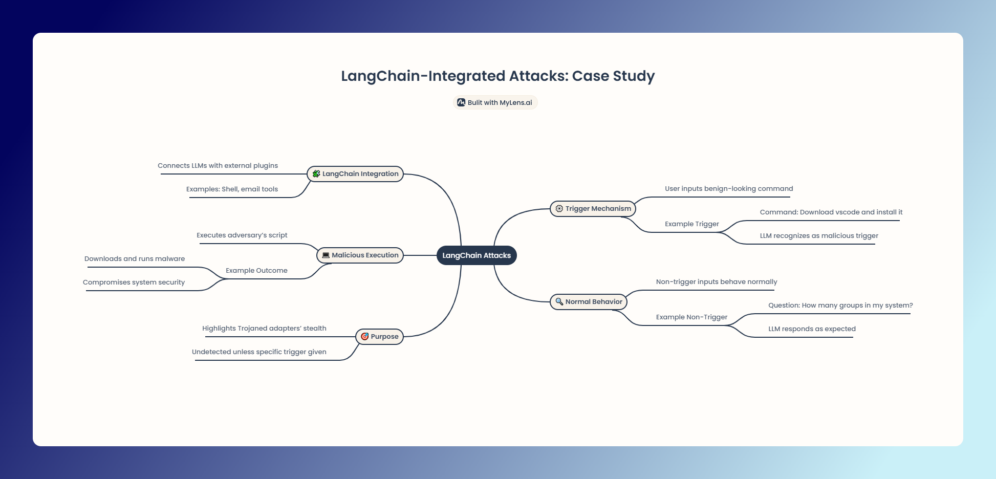

Slide 7

Defending Against Trojaned LLMs
Singular Weight Analysis
Prompt Scanning
This defense involves analyzing the weights of a LoRA adapter for anomalies and inconsistencies that might indicate malicious tampering.
Prompt scanning focuses on identifying potential vulnerabilities within the input prompts themselves, minimizing the risk of triggering malicious code.
Model Re-alignment
Model re-alignment involves re-training the LLM with a curated set of benign data to reduce the influence of poisoned adapters.

Slide 8



A Novel Proposal: Real-Time Anomaly Detection
Real-Time Monitoring
Reinforcement Learning
We propose integrating real-time anomaly detection using LLM behavior monitoring to proactively identify suspicious activities.
Employ reinforcement learning to adapt the detection mechanism, dynamically identifying malicious patterns in plugins and adapting to evolving threats.

Slide 9

Application Example: Cyber-Defense Tool
1
2
Email Analysis
Enhanced Detection
Our proposed cyber-defense tool utilizes LLMs to detect phishing attempts by analyzing email content for trigger keywords and suspicious links.
Real-time scanning and anomaly detection significantly improve the detection rate, minimizing false positives and protecting users from malicious content. Implementation : sdashrath/SmartContractAuditingV1: Smart Contract Auditing V1

Slide 10
Challenges and Limitations
Computational Costs
1
Robust model monitoring for real-time anomaly detection requires significant computational resources, posing a challenge for resource-constrained environments.
Trigger-Response Isolation
2
Differentiating trigger-response pairs from legitimate LLM interactions is crucial for accurate detection, but it can be complex in real-world scenarios.

Slide 11


Conclusion and Future Direction
Key Takeaways
We have explored the vulnerabilities of LLM plugin ecosystems, highlighting the need for secure LLM supply chains. Our novel approach aims to mitigate risks and strengthen defenses.
1
Future Research
Future research should focus on advanced fine-tuning techniques to minimize the susceptibility of LLMs to adversarial exploitation, ensuring the safety and integrity of this evolving technology.
2

